Slide 1
Classification of Houses based on Price Range using Neural Networks and Tree Classifiers from AHS 2017 Dataset
Course Name:
CPE-695A Applied Machine Learning
Professor:
Prof. Shucheng Yu
Team Members:
Darp Raithatha
Likith Nandigam
Monami Mukhopadhyay

Slide 2
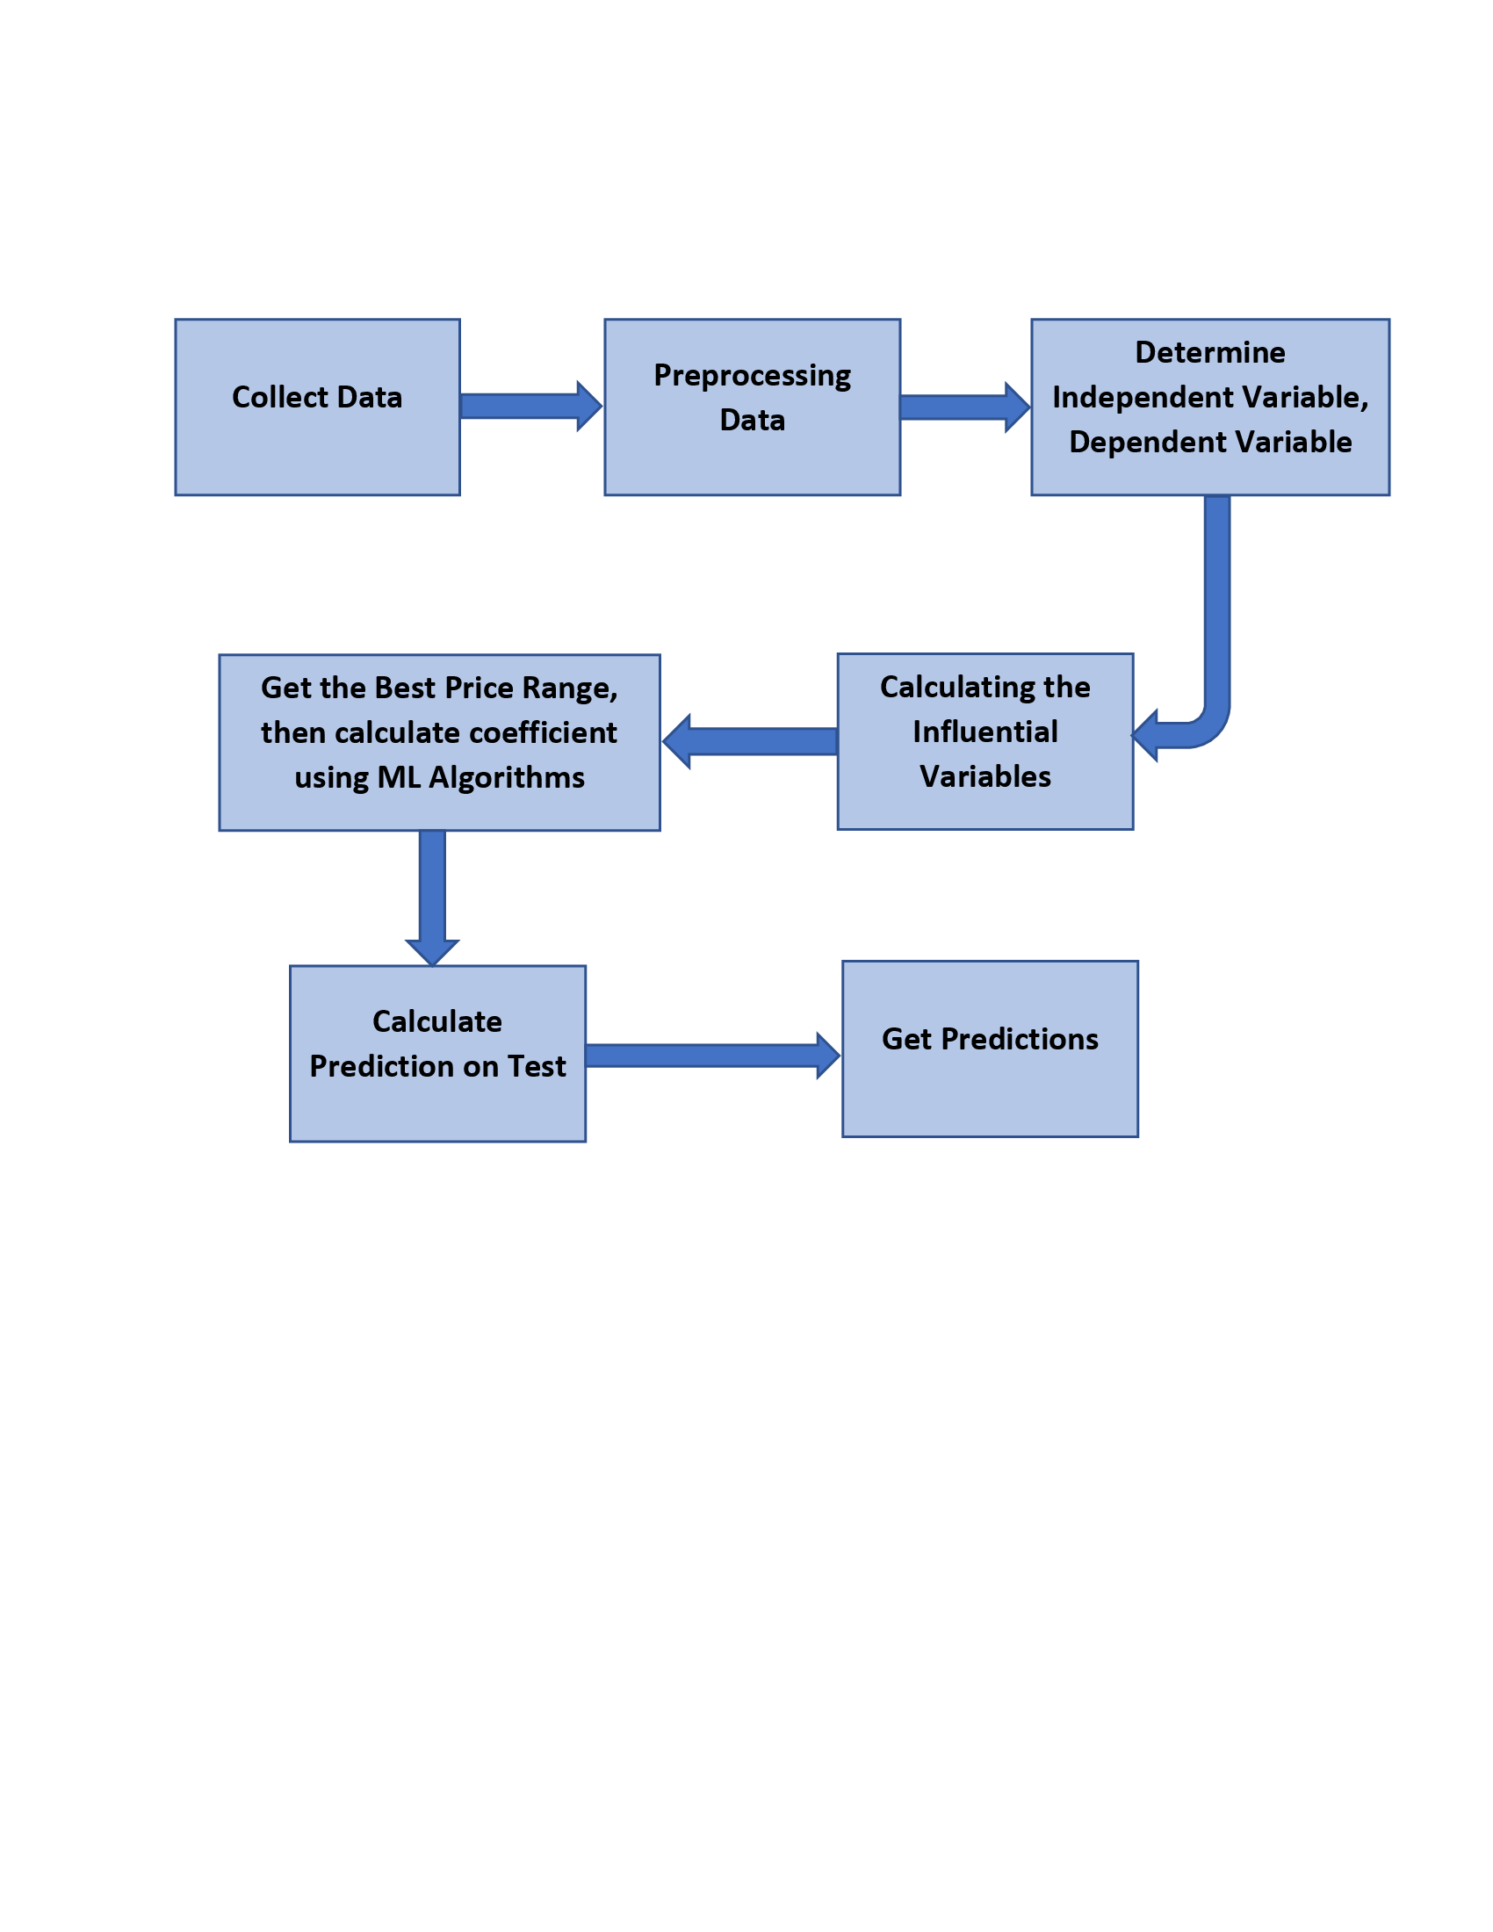
Problem Description
Problem:
Knowing what price tag to put on a house that you plan to sell
You might want a computer algorithm to give you an accurate estimate.
Solution:
The main goal of this project is to predict the range of selling price of house with a high degree of predictive accuracy using various Machine Learning methods.
Given house sale data or explanatory variable such as number of bedrooms, number of bathrooms in unit, housing cost, annual commuting cost etc, we build our model.
Next, the model is evaluated with respect to test data, and plot the prediction and coefficients. In this way we can calculate house valuation in a given geographical area.
A model like this would be very valuable for a real state agent who could make use of the information provided in a daily basis.

Slide 3
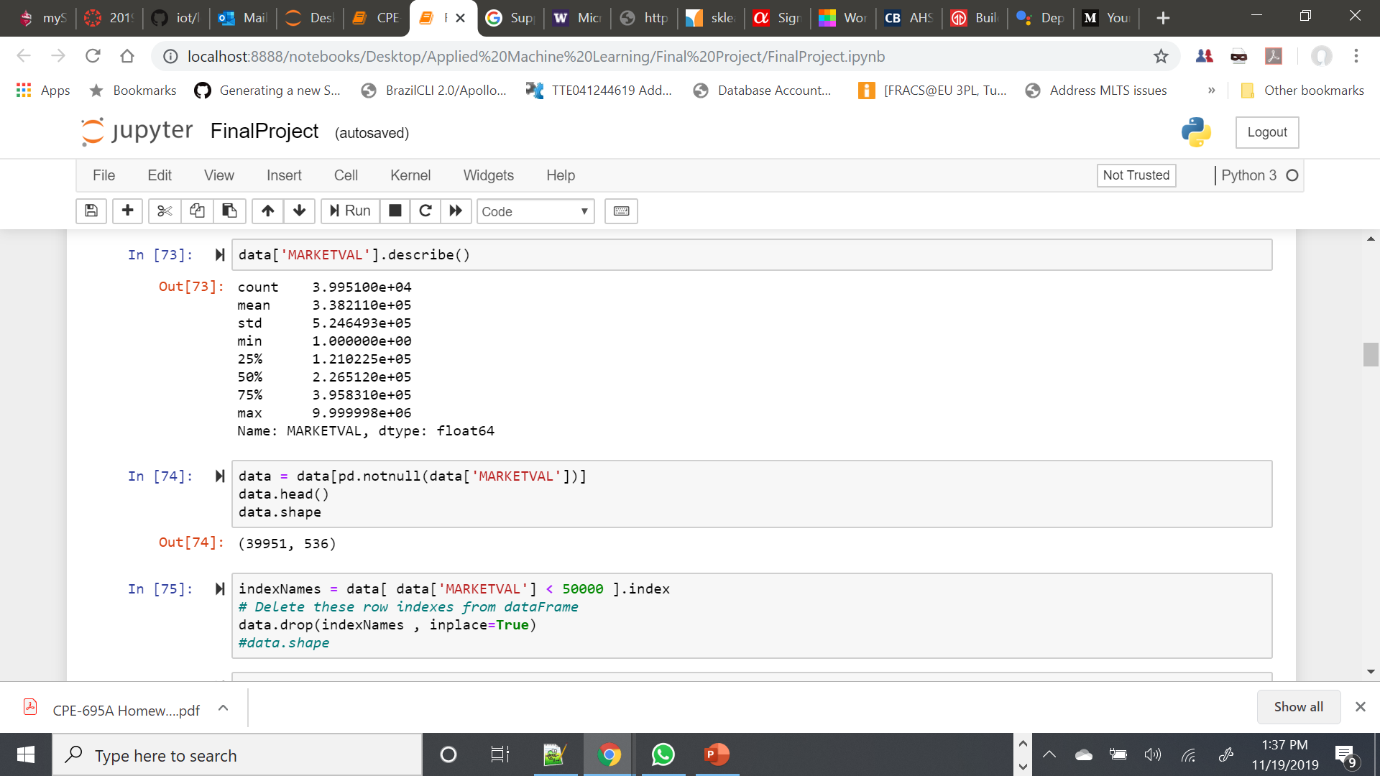
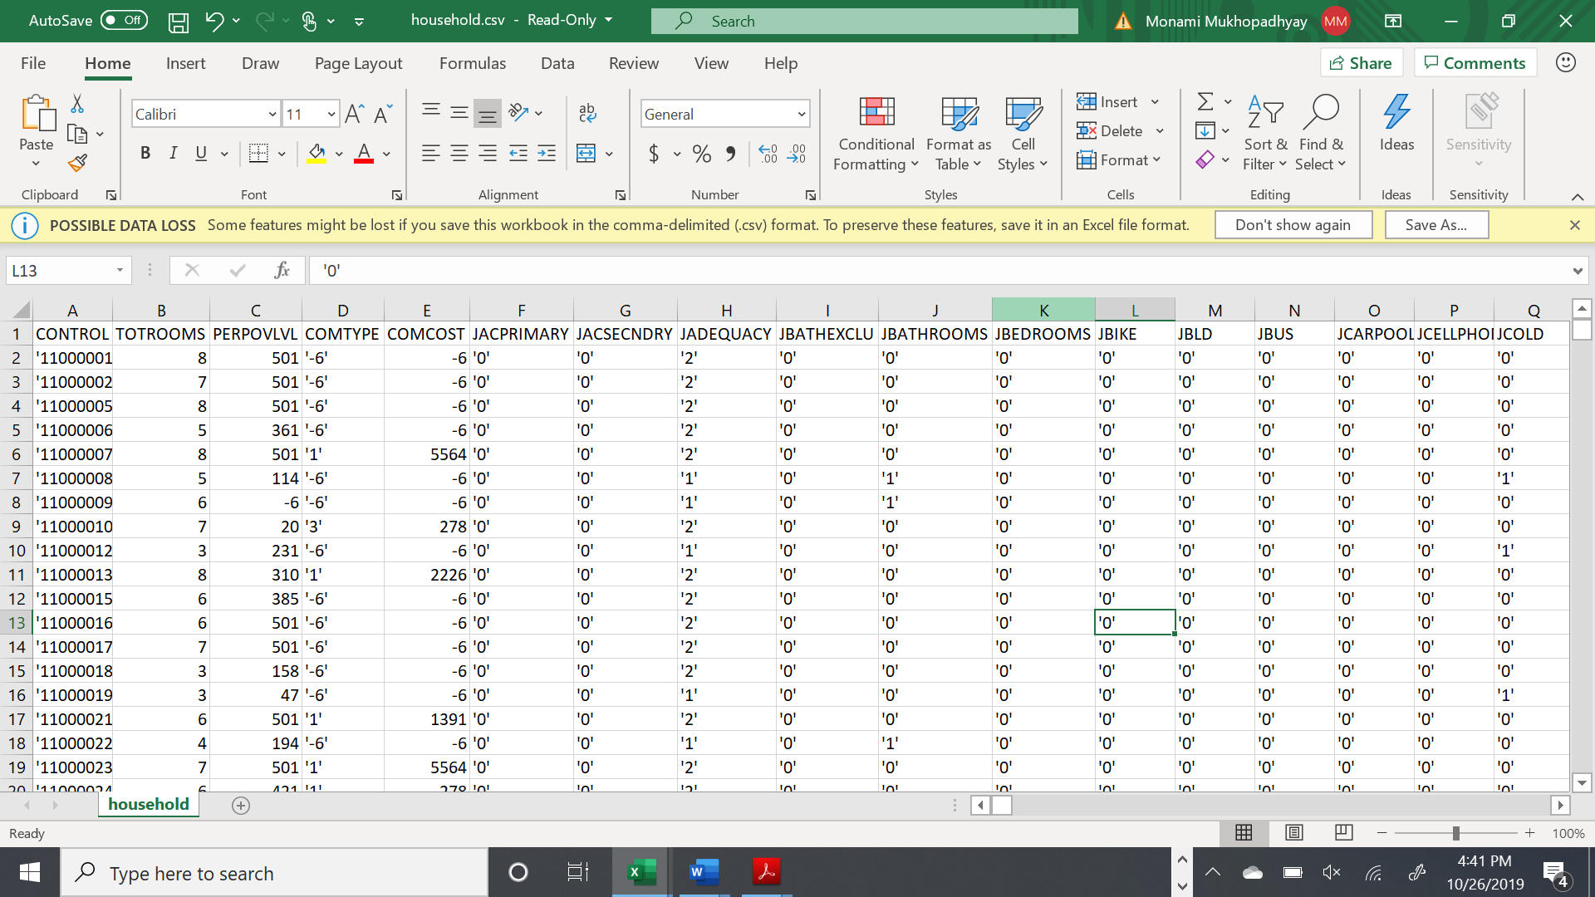
Dataset Description
Dataset Used
We are using American Housing Survey 2017 data (household.csv in AHS 2017 National PUF v3.0 CSV.zip)
RangeIndex: 66752 entries, 0 to 66751
Columns: 1090 entries
Data Exploration
Some of the features can be summarized as:
MARKETVAL (target column) – Current market value of unit
PROTAXAMT – Monthly property tax amount
INSURAMT – Monthly homeowner or renter insurance amount
TOTROOMS – Number of rooms in unit
BEDROOMS – Number of bedrooms in unit
HINCP - Household Income (past 12 months)

Slide 4
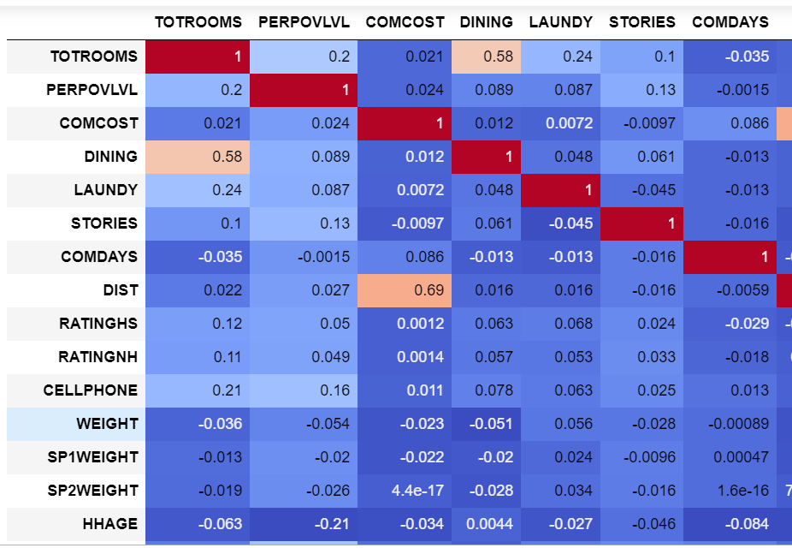
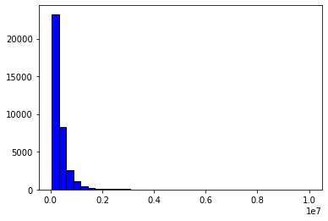
Data Handling
Data Cleaning
The dataset was cleaned to make it free from erroneous or irrelevant data. By filling up missing values, removing rows and reducing data size, the final dataset was (36358 rows X 526 columns)
Feature Observation
All features were evaluated to reduce the dimensionality of the dataset and to check which amongst all features is the most correlated feature for price prediction.
Refine Data
The distribution of data was critically analyzed to derive relevant statistics. Then the data was checked for inconsistencies and removed accordingly.

Slide 5
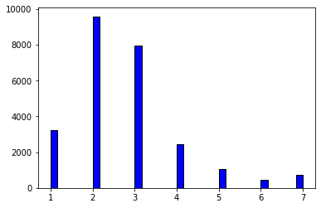
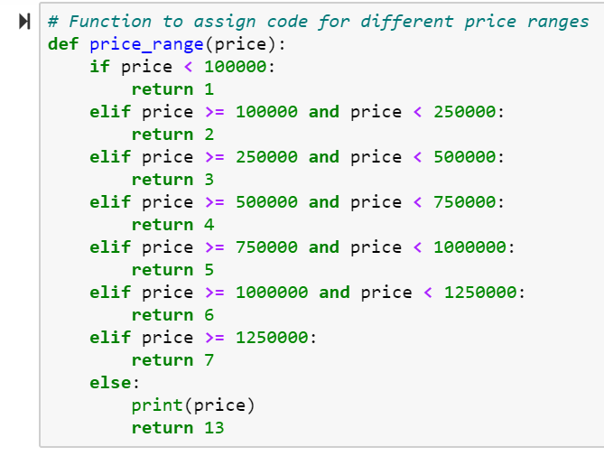
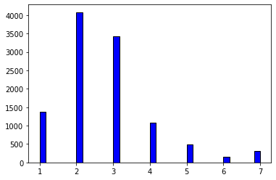
Feature Encoding
Train
To predict the price range for houses, we divided the entire range of MARKETVAL values into smaller ranges and encoded them into set of classes as [1,2,3,4,5,6,7,13]. The function used for the same is as below:
Test

Slide 6
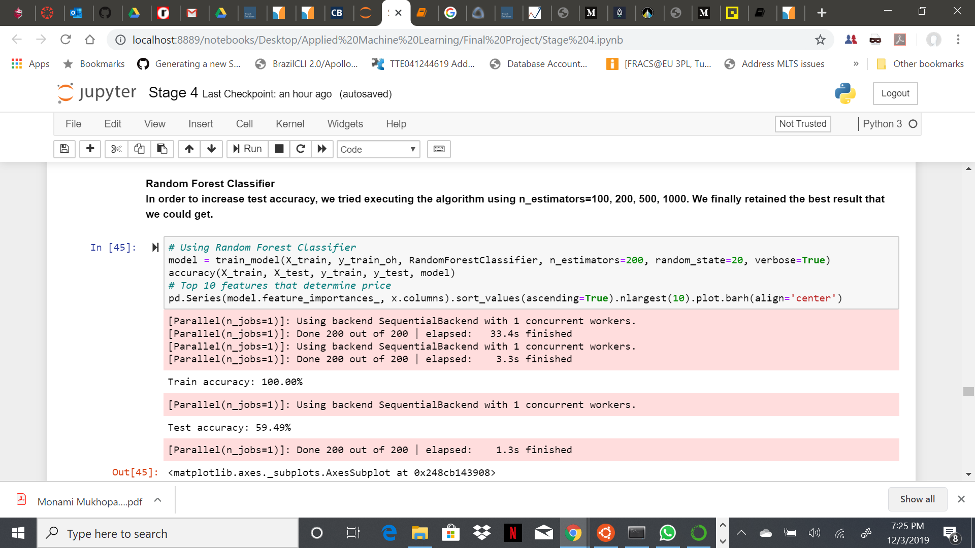
Results Obtained – Random Forest Classifier
The random forest is a classification algorithm consisting of many decision trees. It uses bagging and feature randomness when building each individual tree to try to create an uncorrelated forest of trees whose prediction by committee is more accurate than that of any individual tree.
In order to increase test accuracy, we tried executing the algorithm using n_estimators=100, 200, 500, 1000. We finally retained the best result that we could get.
Results: With RandomForestClassifier, the accuracy score were as below:
Training Accuracy – 100.00%
Testing Accuracy – 59.49%

Slide 7
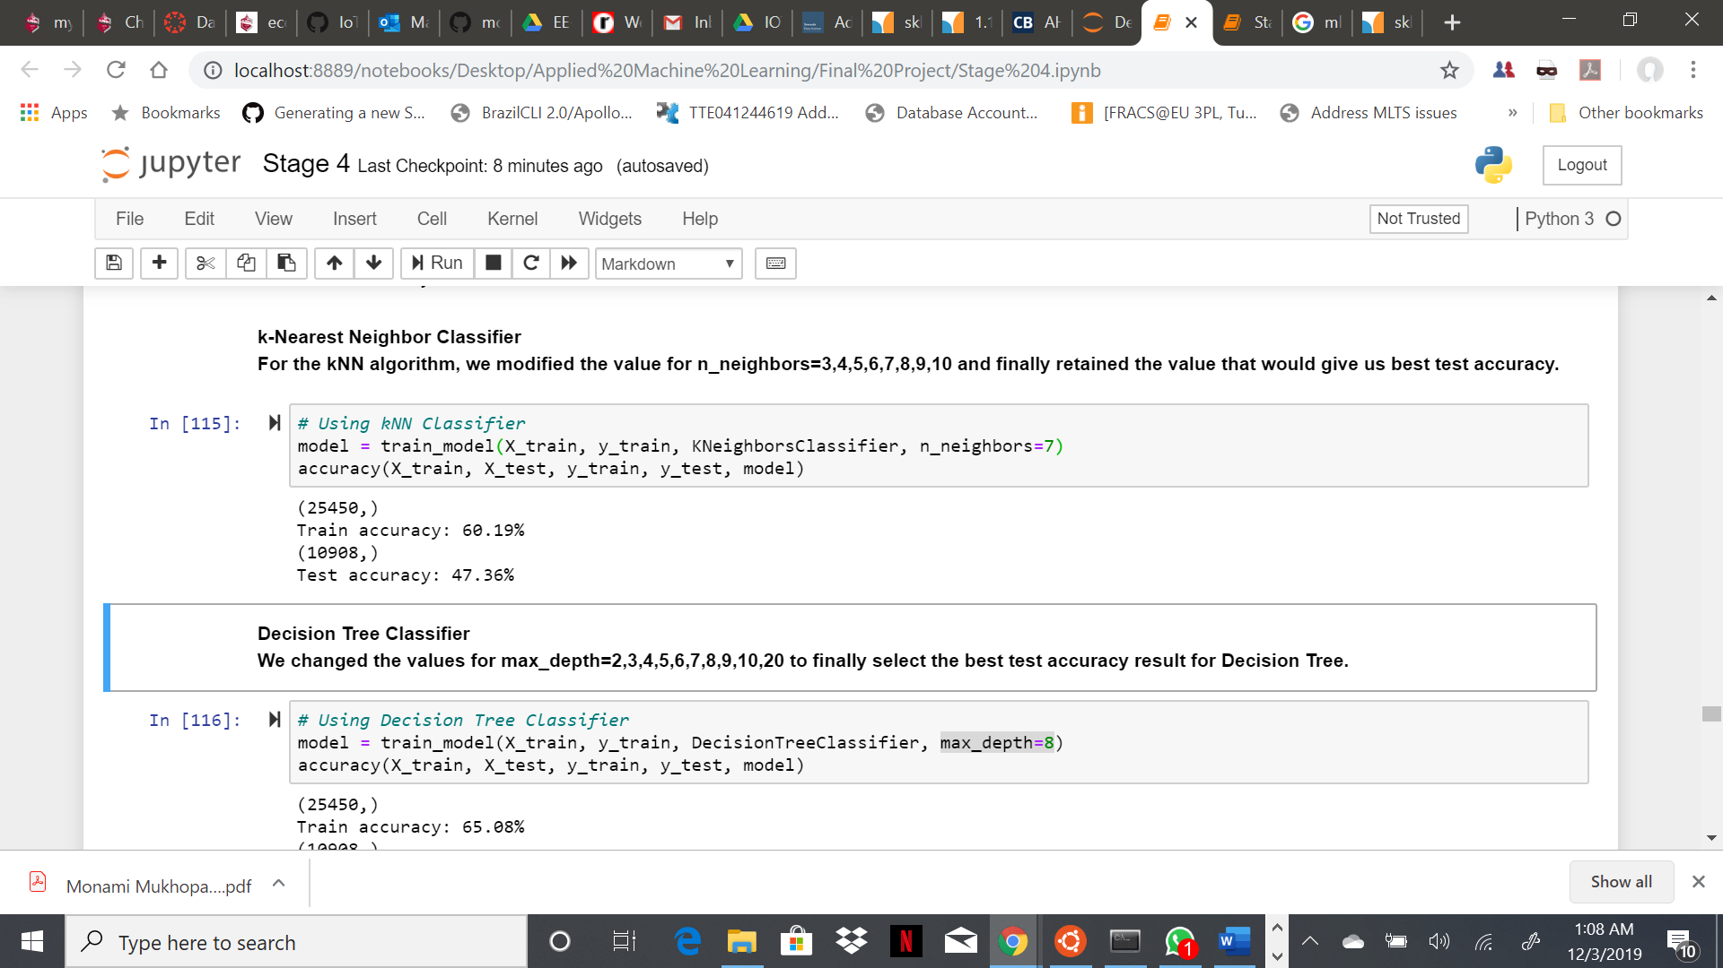
Results Obtained – k-Nearest Neighbors Classifier
KNN or k-nearest neighbours is the simplest classification algorithm. This classification algorithm does not depend on the structure of the data. Whenever a new example is encountered, its k nearest neighbours from the training data are examined. Distance between two examples can be the euclidean distance between their feature vectors. The majority class among the k nearest neighbours is taken to be the class for the encountered example.
For the kNN algorithm, we modified the value for n_neighbors=3,4,5,6,7,8,9,10 and finally retained the value that would give us best test accuracy.
Results: With KNeighborsClassifier, the accuracy score were as below:
Training Accuracy – 60.19%
Testing Accuracy – 47.36%

Slide 8
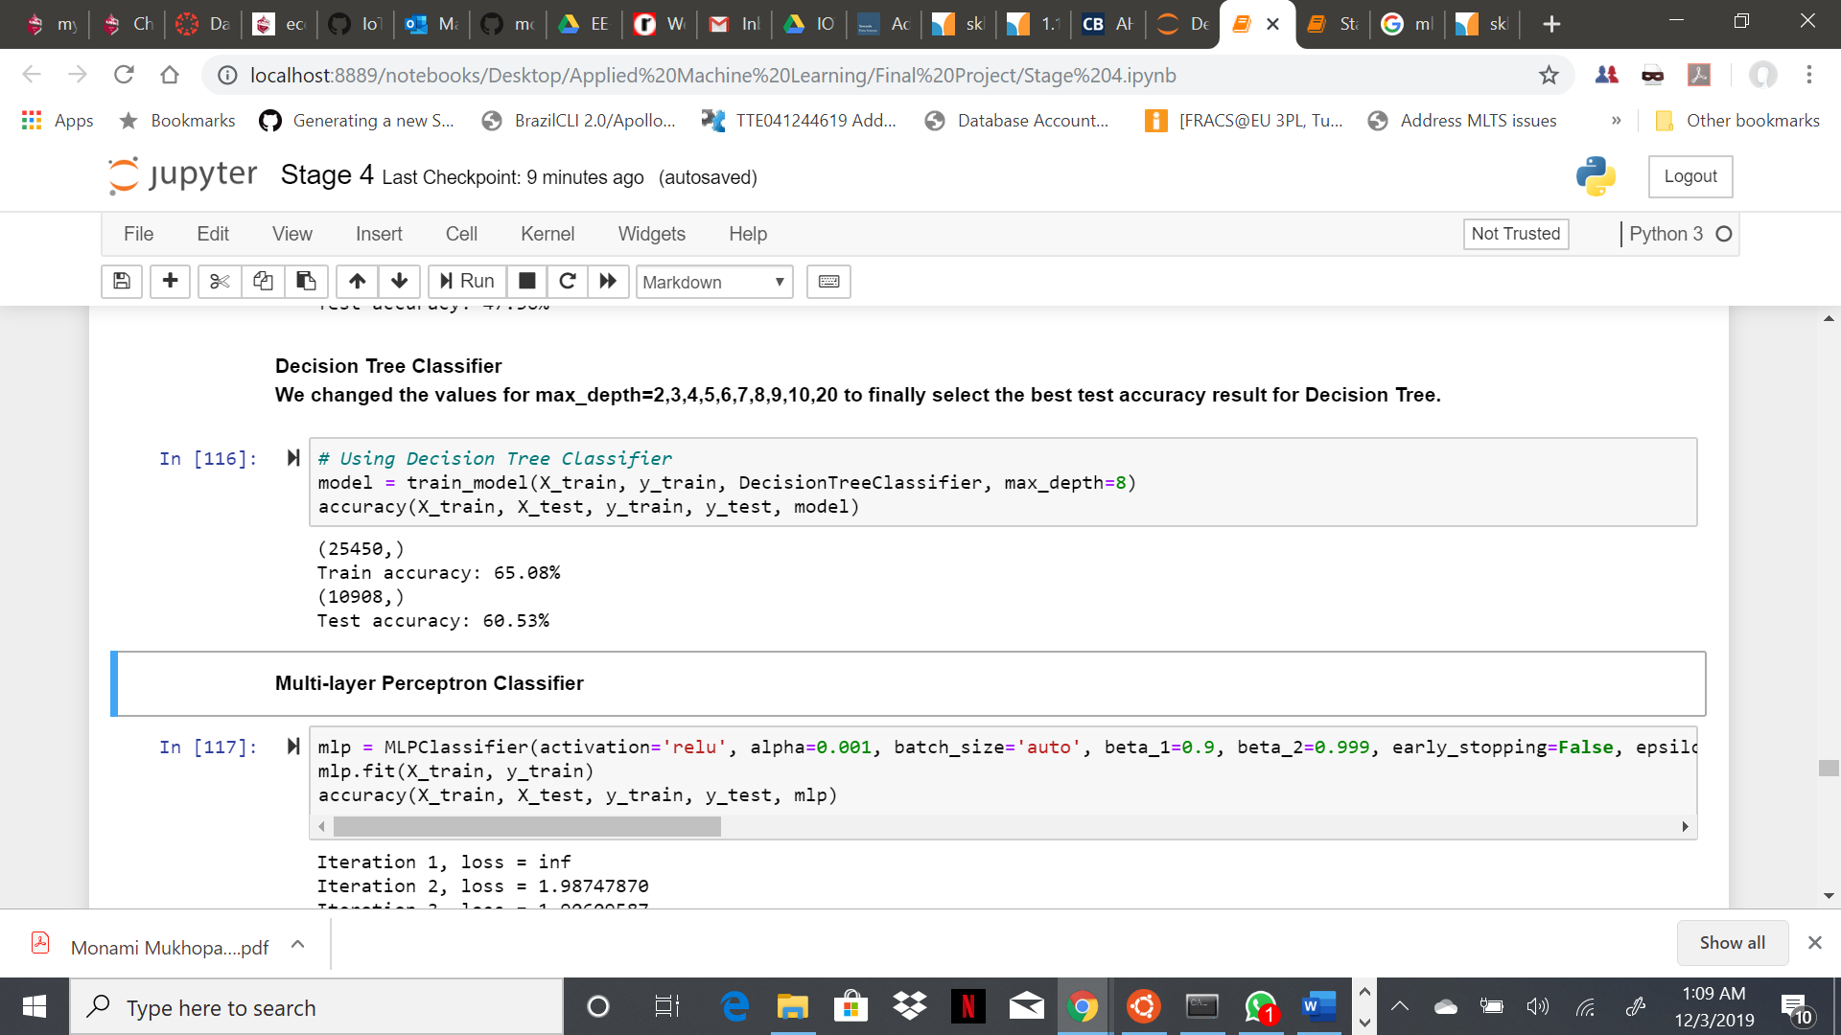
Results Obtained – Decision Tree Classifier
Decision Tree Classifier is a simple and widely used classification technique. Decision Tree Classifier poses a series of carefully crafted questions about the attributes of the test record. Each time it receive an answer, a follow-up question is asked until a conclusion about the class label of the record is reached.
We changed the values for max_depth=2,3,4,5,6,7,8,9,10,20 to finally select the best test accuracy result for Decision Tree.
Results: With DecisionTreeClassifier, the accuracy score were as below:
Training Accuracy – 65.08%
Testing Accuracy – 60.60%

Slide 9
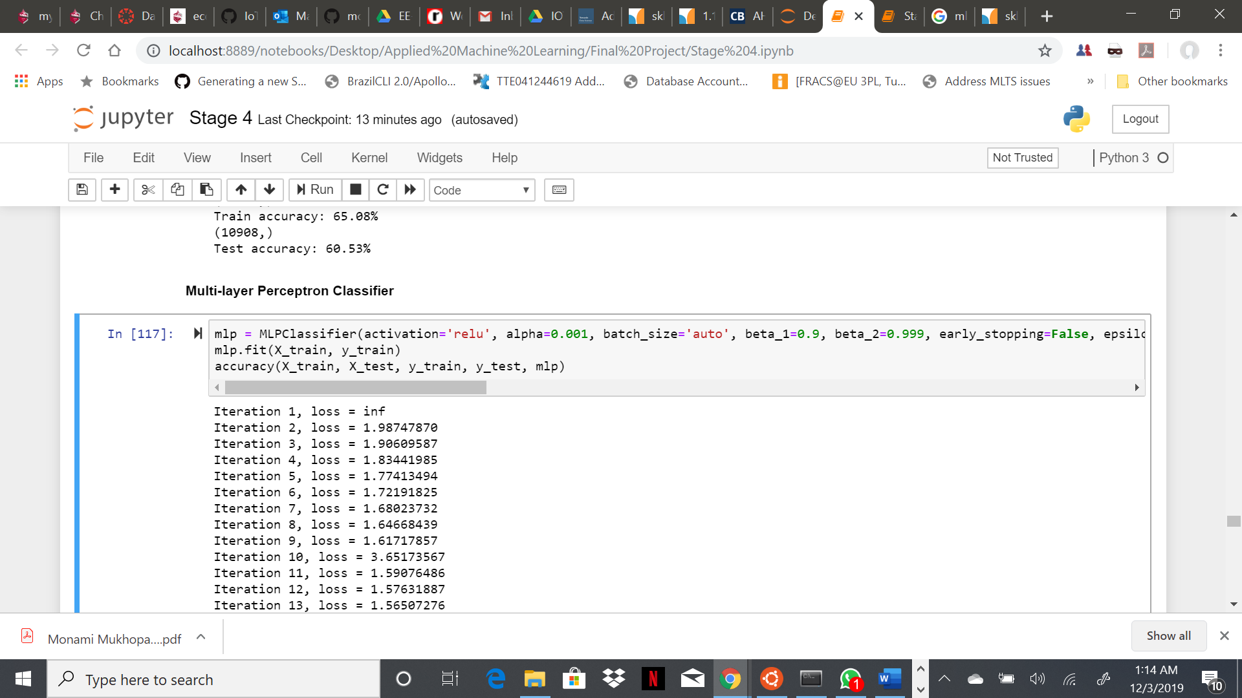
Results Obtained – Multi-layer Perceptron Classifier
MLPClassifier relies on an underlying Neural Network to perform the task of classification. A multilayer perceptron (MLP) is a feedforward artificial neural network model that maps sets of input data onto a set of appropriate outputs.
We tried different values for alpha, max_iter and solver to get the best accuracy results.
Results: With MLPClassifier, the accuracy score were as below:
Training Accuracy – 37.65%
Testing Accuracy – 37.40%

Slide 10
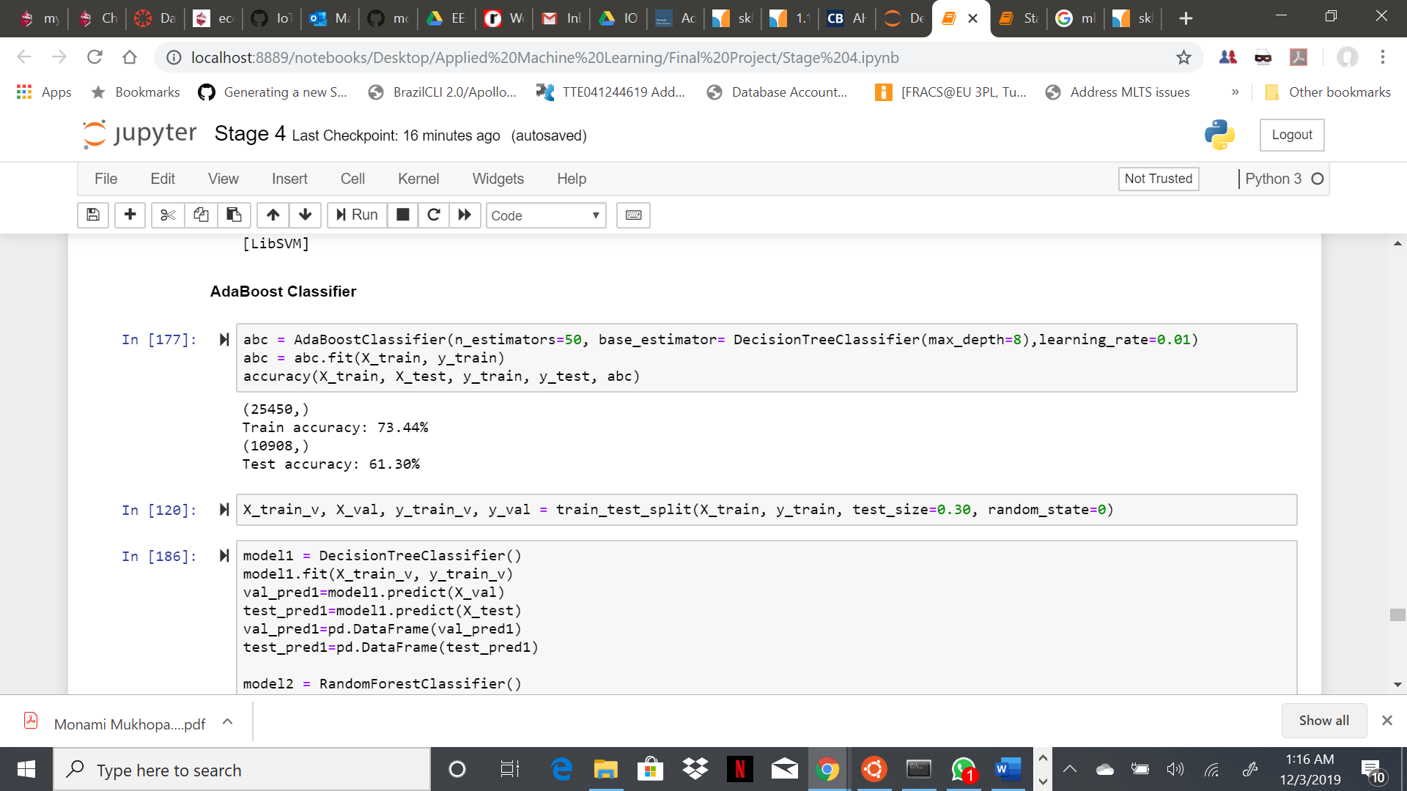
Results Obtained – AdaBoost Classifier
Ada-boost classifier combines weak classifier algorithm to form strong classifier. A single algorithm may classify the objects poorly. But if we combine multiple classifiers with selection of training set at every iteration and assigning right amount of weight in final voting, we can have good accuracy score for overall classifier.
For AdaBoostClassifier, we used n_estimators=20,50,70,100,300,500,1000, max_depth=3,4,5,7,8,20,15,20, learning_rate=0.1,0.3,0.5,0.01,0.08,0.003. Finally we got below best accuracy values.
Results: With AdaBoostClassifier, the accuracy score were as below:
Training Accuracy – 73.54%
Testing Accuracy – 61.29%

Slide 11
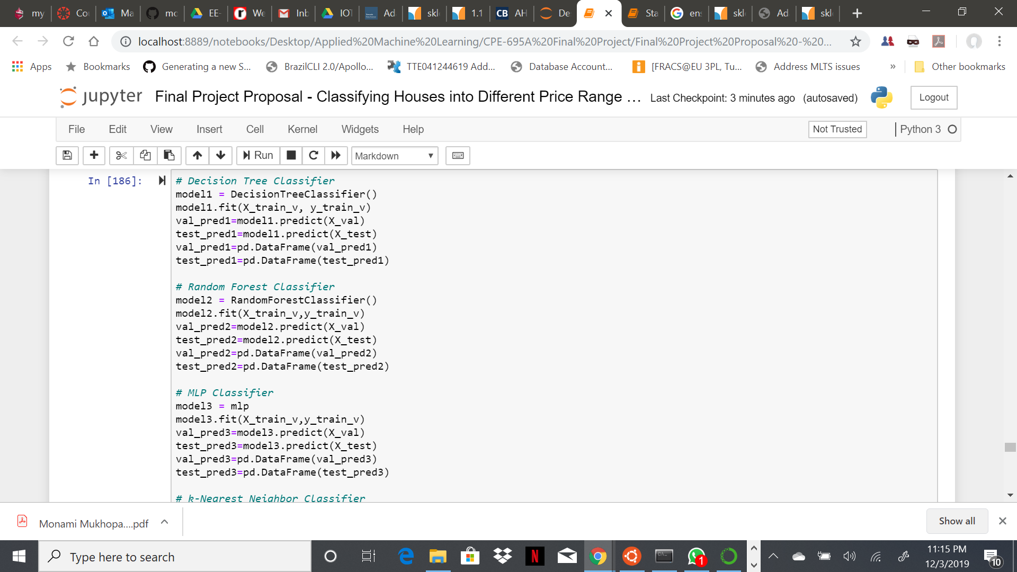
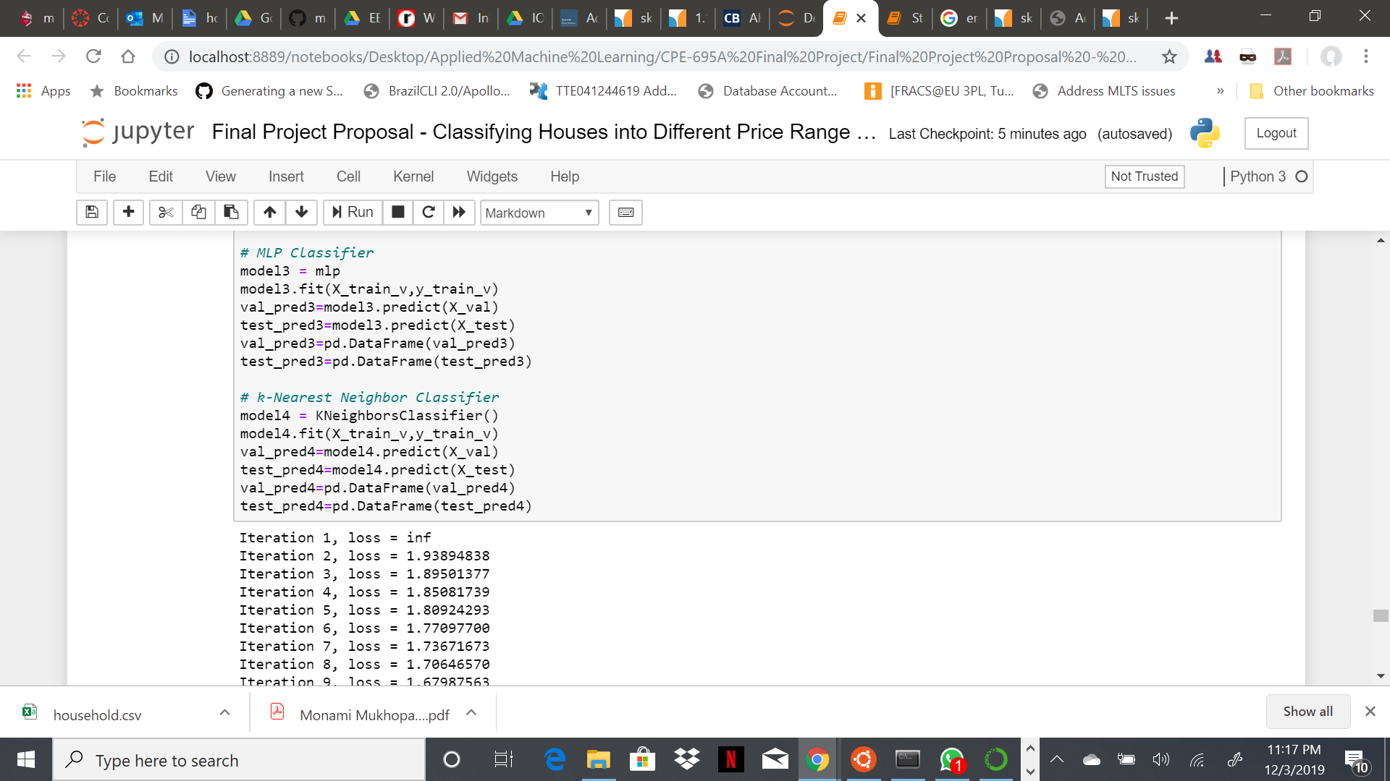
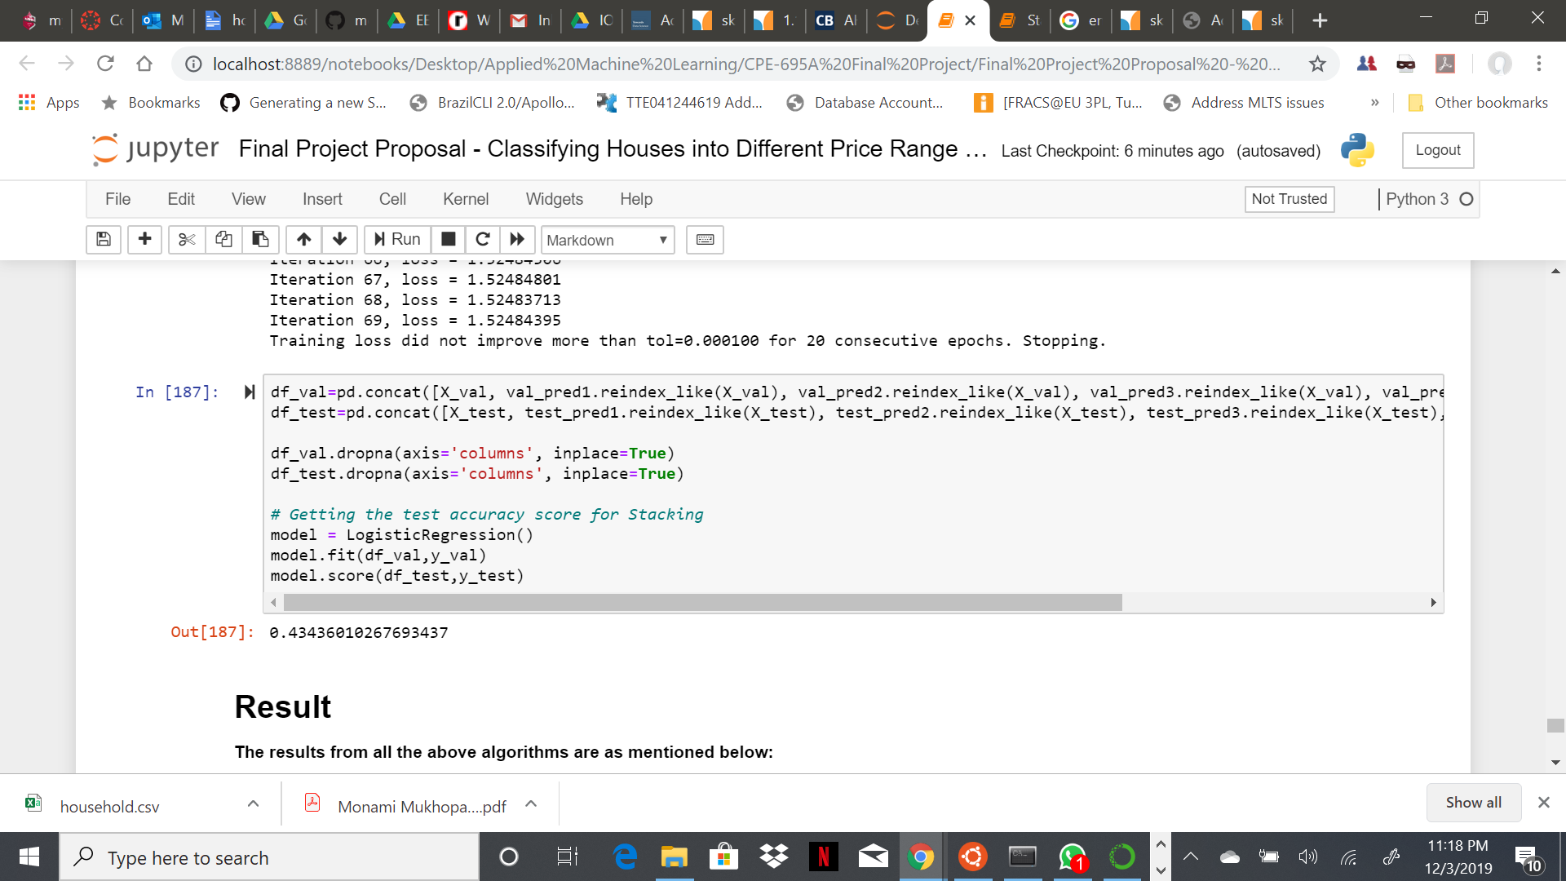
Results Obtained – Ensemble Method (Stacking)
Stacking is an ensemble learning technique that combines multiple classification or regression models via a meta-classifier or a meta-regressor. The base level models are trained based on a complete training set, then the meta-model is trained on the outputs of the base level model as features.
Results: With Stacking, the accuracy score were as below:
Testing Accuracy Score – 0.43436010267693437

Slide 12
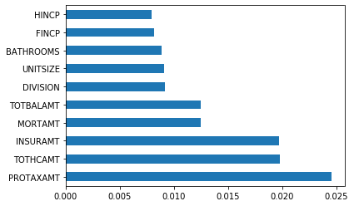
Feature Importance
Using Random Forest, we plotted a bar graph representing the top 10 features based on their importance in determining the house price range.
These 10 features are as below:
PROTAXAMT- Monthly Property Tax Amount
TOTHCAMT- Monthly Total Housing Cost
INSURAMT- Monthly Homeowner or Renter Insurance Amount
MORTAMT- Monthly Total Mortgage Amount (all mortgages)
TOTBALAMT- Total Remaining Debt Across all Mortgages or Similar Debts for this Unit
DIVISION- Census Division
UNITSIZE- Unit Size (Square Feet)
BATHROOMS- Number of Bathrooms in Unit
FINCP- Family Income (Past 12 Months)
HINCP- Household Income (Past 12 Months)

Slide 13
Conclusion
We explored a range of different models, from relatively simple to more complex ones, with the goal of best predicting home price ranges but also utilizing different data science skills in the process.
For this particular problem, the algorithm with best accuracy value is AdaBoost Classifier with test accuracy score of 61.29% and therefore it can be considered as a good classifier algorithm for house price range prediction problem.
The Decision Tree Classifier is close enough with 60.60% accuracy score.
We have tried tuning each algorithm with different hyper-parameter values and finally kept the best results for each, thereby attaining hyper-parameter optimization.
<Please add some conclusive comment>
Github Repository –
Google Drive -

Slide 14

Individual Contribution
Each of the members had unique contributions towards the project. But there are areas where all three of us are working together as well.
Darp Raithatha is responsible for preliminary research, gathering information, correlation determination, external materials to refer to, model evaluation and code testing.
Likith Nandigam is responsible for cleaning the dataset, compiling the code, code testing, result extraction, and documentation.
Monami Mukhopadhyay is responsible for code testing, result extraction, project compilation, documentation, gathering and implementing references.

Slide 15
Thank you

